Slide 1
Bangalore Metro Station Clustering

Slide 2
Objective
The objective is to analyse the venues near various Metro Stations in Bangalore
This could be used to identify the type of people or the purpose for which people often use the metro
The data can also be used to identify the type of development happening in different regions of Bangalore.

Slide 3
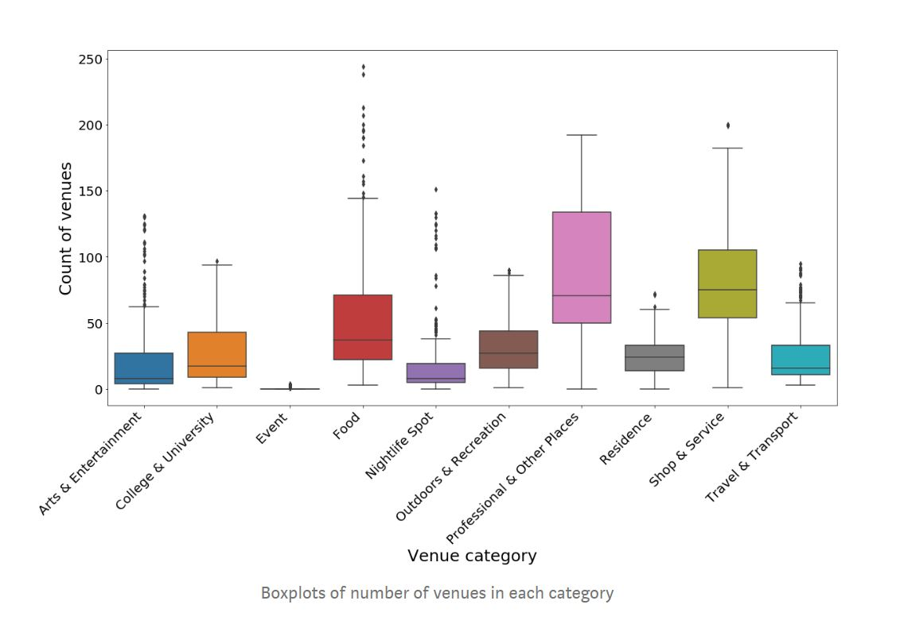
Box Plot

Slide 4
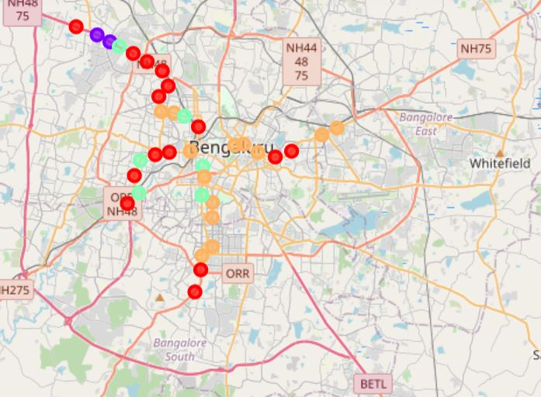
Clustering

Slide 5
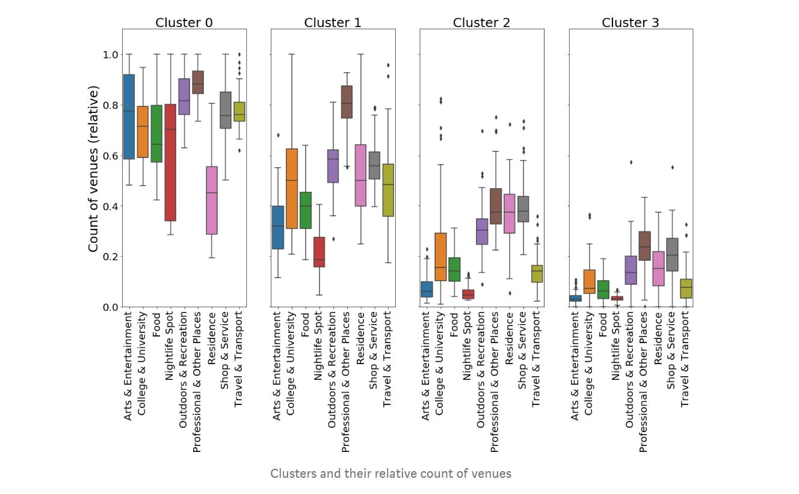
Clusters in box Plot

Slide 6
Thank You

